Slide 2
The Future of Virtualization
Arjan van de Ven

Slide 3
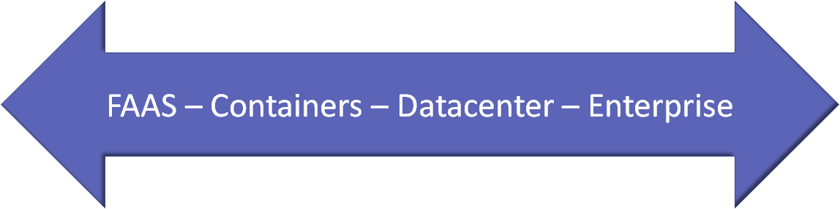
Notes:
Virtual technology is no longer about enterprise being a fake pc.

Slide 4


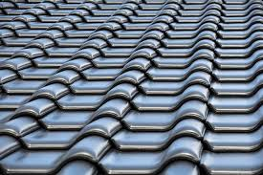


Technology Shift
Lightweight
Fast
High Density
Quick Start-up
Secure
Notes:
This change needs a fundamental technology shift
From light-weight to fast to high density to quick start-up to secure
The incumbent old style technology has to change

Slide 5
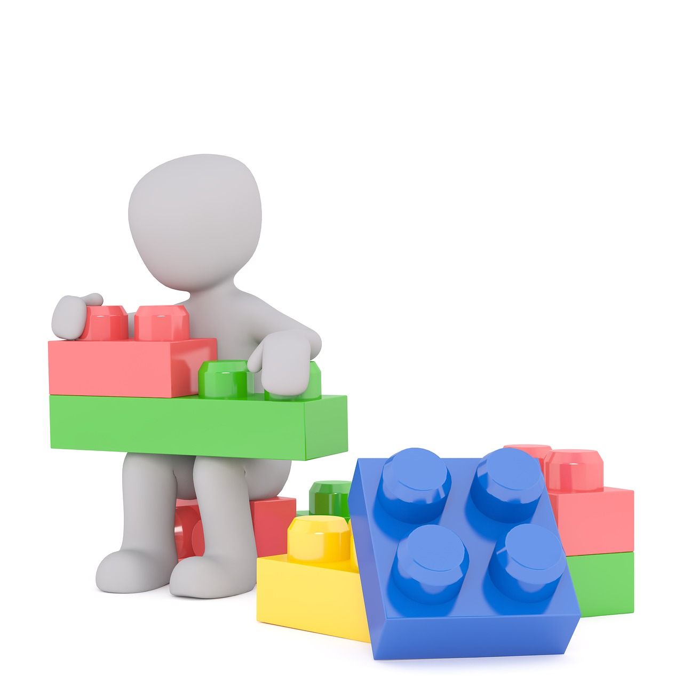
rust-vmm
Memory Model
virtio
Paravirtualization
PCI
vhost
Device Model
KVM Abstraction
VFIO
ACPI
Notes:
rust-vmm is an effort coming out of firecracker and crosvm.
These are the rustvmm components.
blocks which you can build multiple hypervisors

Slide 6
Cloud Hypervisor
Virtual Machine
Rust-vmm
Memory Model
virtio
Paravirtualization
Device Backend
Rust-vmm
PCI
vhost
Device Model
Rust-vmm
Device Backend
KVM Abstraction
VFIO
ACPI
Device Backend
Cloud Hypervisor
Rust-vmm
KVM
Linux* Kernel
https://github.com/intel/cloud-hypervisor
*Other names and brands may be claimed as the property of others.
Notes:
example of what we build to make sure it all works together.

